Slide 1
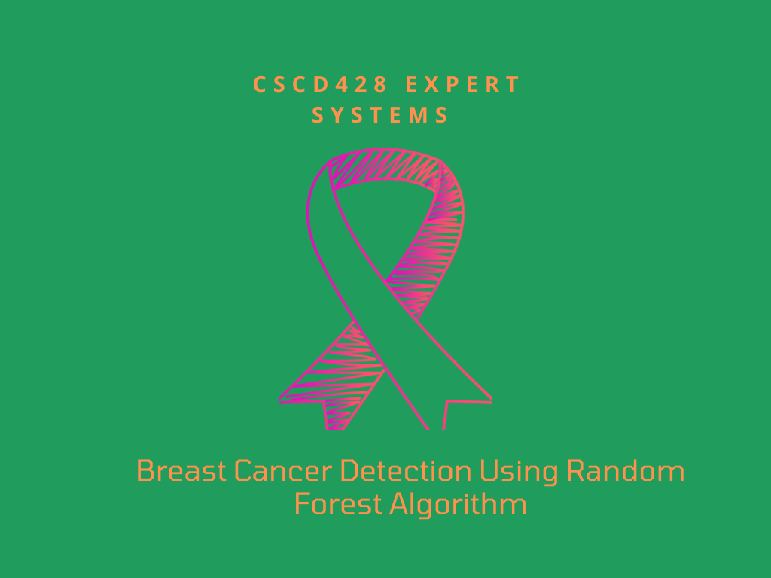

Slide 2
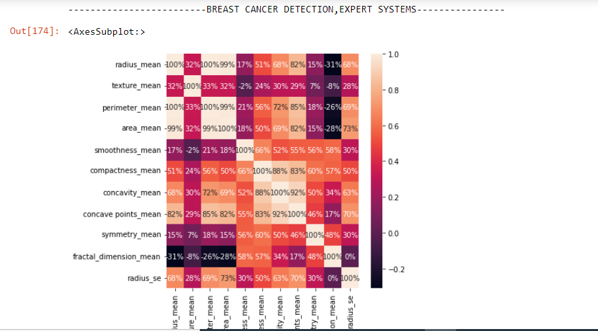

Slide 3
PROBLEM
Breast cancer cases are on the rise in Ghana with older adult women being more at risk
It occurs when some breast cells begins to grow abnormally
It is estimated that, about 4.5% of older adult Ghanaian women have breast cancer

Slide 4
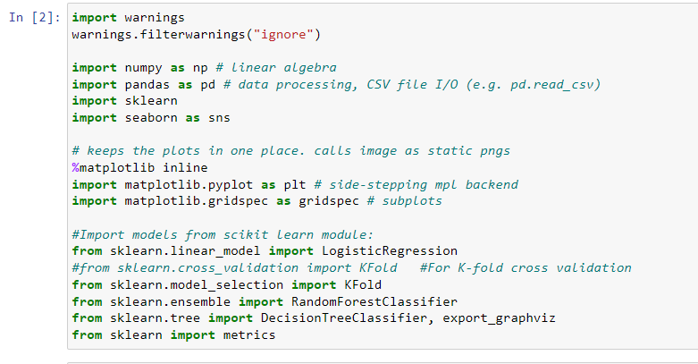
Importing the necessary packages

Slide 5

Performing basic data cleaning
Read the data
We want to drop all columns with null values

Slide 6
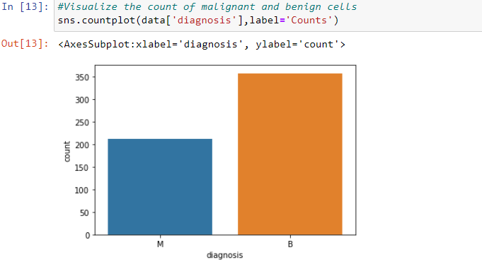
EXPLORATORY DATA ANALYSIS

Slide 7
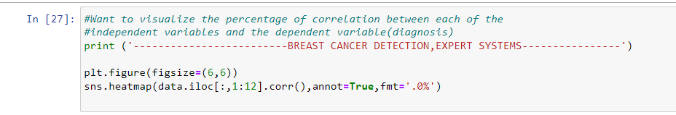
CORRELATION

Slide 8
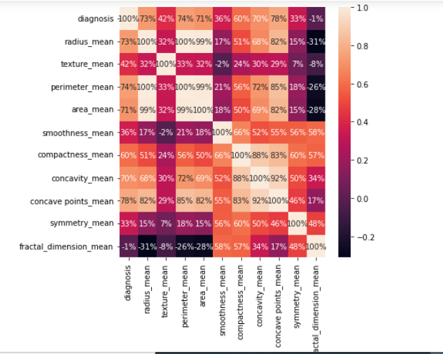
Percentage of Correlation

Slide 9
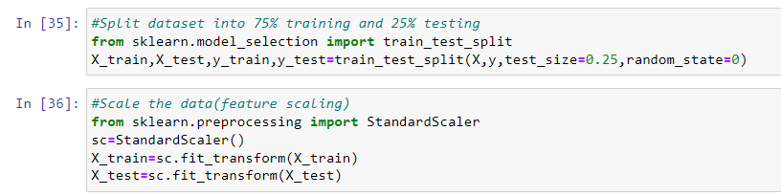
Now the model
We split the dataset into training and testing with test size=25% of the entire data and then proceed to scale the data

Slide 10
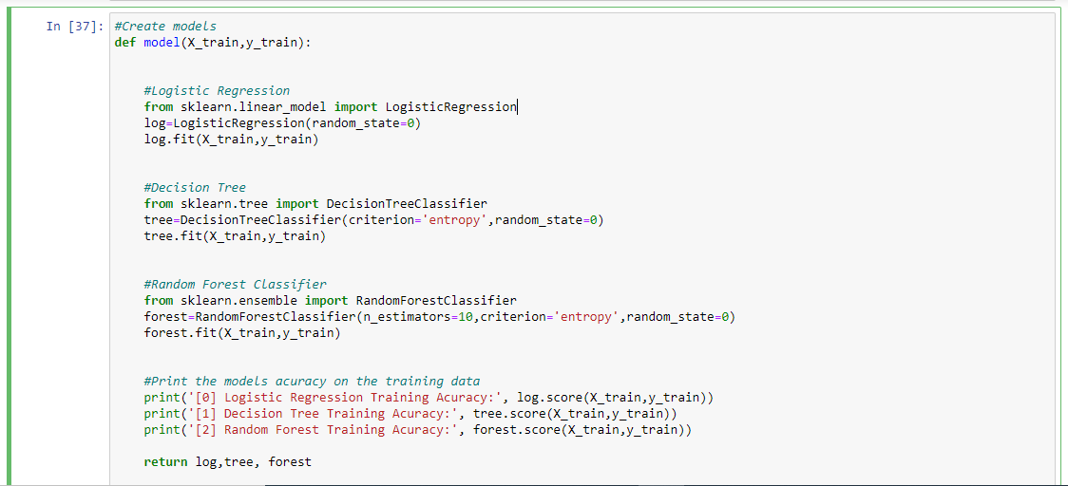
We define a function to create 3 different models

Slide 11
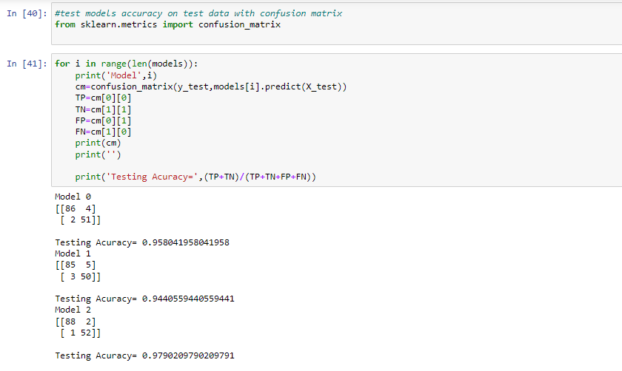
Testing the three models on the test data

Slide 12
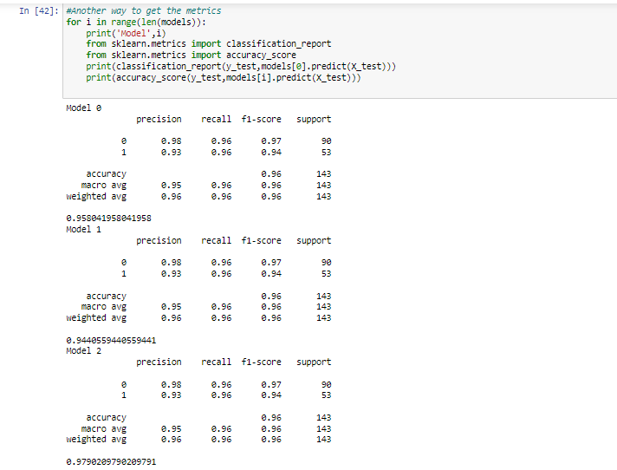
Another way to get the predictions

Slide 13
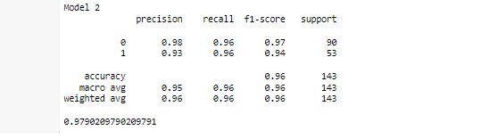
The Random Forest Model
The model with the best accuracy on predictions is the random forest model. Let’s take a look at its predictions again

Slide 14
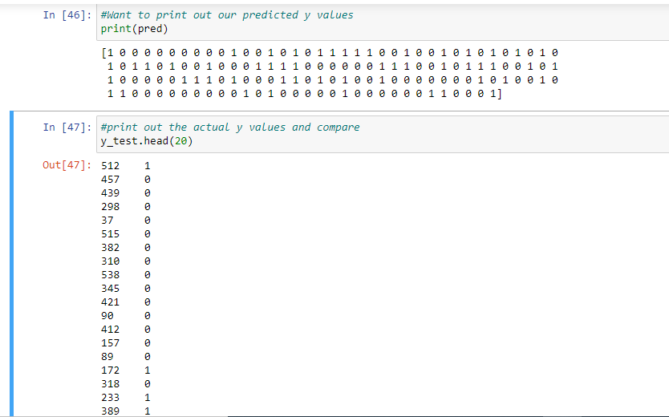
Comparing the predicted y values with the actual y values

Slide 15
Thank you!

Slide 16
Group Membership
Name | ID
Lincoln Seyram Foli-Washington | 10716747
Arkoh Abigail | 10687470
Elvis Boateng | 10711434
Patrick Azuma Attankurugu | 10679907
Larbi Ransford Obiri Jnr | 10681368
Prince Ntiamoah | 10719218
Angelique Foah Kobina | 10679722
Kekeli Agbovi | 10727645
Nurain Dawuda | 10727870
Yaw Opoku Appiah | 10718686
Narh Ama Thereasa | 10706480
Blemano Emmanuel Tetteh | 10724087

